Slide 1
D-PHY GDS Bump Layout Review
DWC MIPI D BD2 TSMC28HPC18NS
JIANGWAN2 Project
Jimmy Xie
August 2017

Slide 2
Agenda
Disclaimer
Project Information
GDS Bump Layout Review

Slide 3
Disclaimer
The purpose of this document is to list items known to be fundamental for the successful integration of this IP. A checklist cannot be exhaustive, therefore use of design best practices and careful reviewing and following all the recommendations in the Databook is still necessary for proper integration and operation of the IP.
Integration Review Services are part of Synopsys Standard Core Support. CAE engineers carry out visual inspection of your implementation to identify common pitfalls.

Slide 4
Project Information
Project Name: JIANGWAN2
IP name, techonology and version: DWC MIPI D BD2 TSMC28HPC18NS - 6.02a (RX6) & 6.02a (TX2)
Target metal stack: 8M_5X2Z
IO type: FC / Package type: FC (SIP)
Cell used: 2x dwc_mipi_2_tx_dphy_ns, 6x dwc_mipi_2_rx_dphy_ns and 2xdwc_mipi_pll_dphy
RTL Freeze Date: N/A
Tapeout Date: Oct 2017

Slide 5
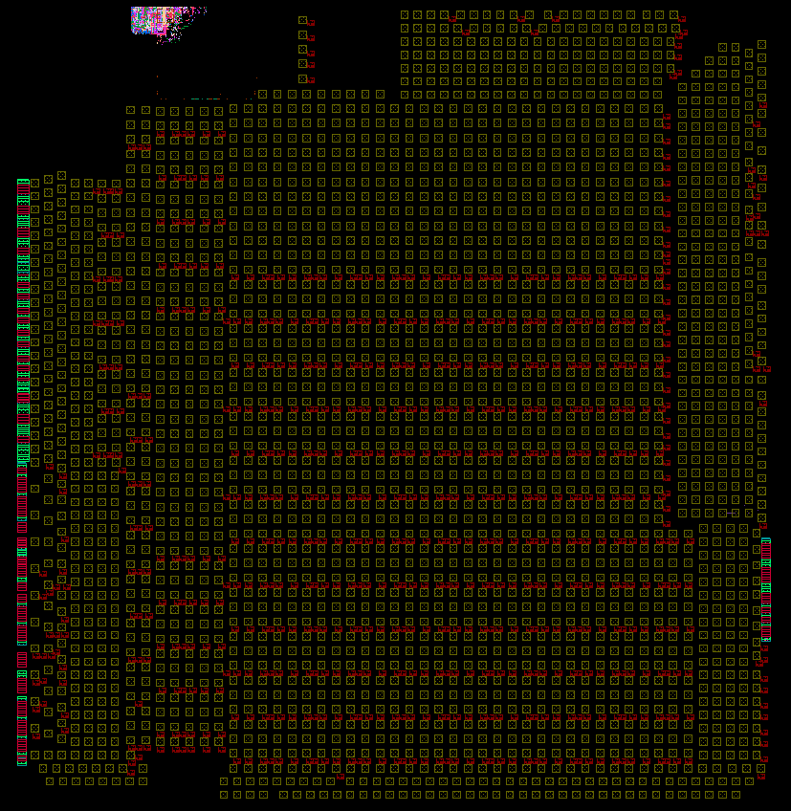
SoC GDS

Slide 6
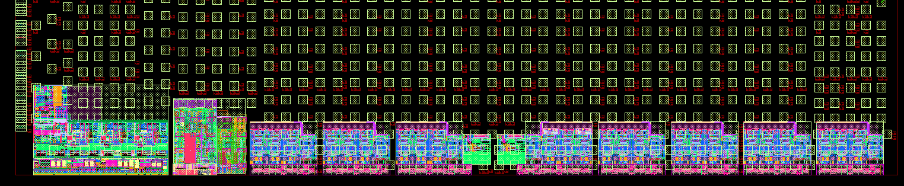
SoC GDS Zoom In

Slide 7
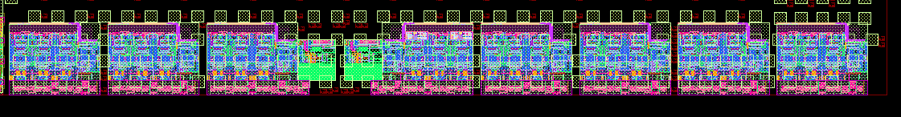
SoC GDS

Slide 8
GDS Layout Review
(a) Is the IP placed away from any noisy circuitry? If not, is an extra 10 µm N-well moat tied to AVDD added?
SNPS: Customer to confirm on top;
(b) Is the IP located on the die periphery of the ASIC
SNPS: Seems ok
(c) Are no devices within a 5 µm region from IP boundary?
SNPS: Seems ok
(e) Are the IO pads connected to IP macro by abutment?
SNPS: Seems ok
(f) Is the PLL connected to IP macro and IO pad ring by abutment? (if PLL is used)
SNPS: One of the PLL (on the right side) must be mirror;
(g) Is the IP correctly orientated in the SoC?
SNPS: Seems ok

